Slide 1
Shear Viscosity of Colloidal Suspensions

Slide 2
Simulated System
Implemented a shearing DPD simulation with equations and dynamics from Pryamitsyn
Viscosity is calculated with a Lees-Edwards system, shear stress is computed and then the integral of this stress autocorrelation function is computed

Slide 3

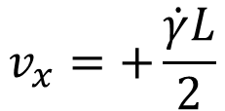


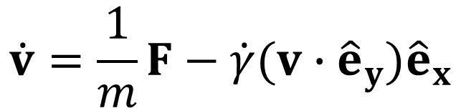
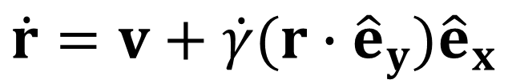
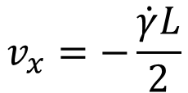
Simulated System
$$y$$
$$x$$
$$v_{x}=+\frac{\dot{γ}L}{2}$$
$$\dot{r}=v+\dot{γ}(r∙{\hat{e}}_{y}){\hat{e}}_{x}$$
$$L$$
$$\dot{v}=\frac{1}{m}F−\dot{γ}(v∙{\hat{e}}_{y}){\hat{e}}_{x}$$
$$v_{x}=−\frac{\dot{γ}L}{2}$$

Slide 4
Interaction Forces
DPD Forces between fluid particles
Inclusive of rotation – Each particle has a velocity and also an angular velocity
Particles can exert off-axis forces and torques on one another
Lennard-Jones potential for fluid-colloid and colloid-colloid pairs
Fluid-colloid potential is much softer than the colloid-colloid pairs

Slide 5
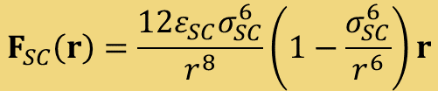

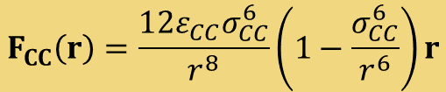


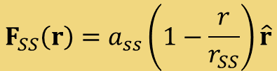
Interaction Forces
$$F_{CC}\left(r\right)=\frac{12ε_{CC}σ_{CC}^{6}}{r^{8}}\left(1−\frac{σ_{CC}^{6}}{r^{6}}\right)r$$
$$r<r_{CC}$$
$$F_{SC}\left(r\right)=\frac{12ε_{SC}σ_{SC}^{6}}{r^{8}}\left(1−\frac{σ_{SC}^{6}}{r^{6}}\right)r$$
$$r<r_{SC}$$
$$F_{SS}\left(r\right)=a_{ss}\left(1−\frac{r}{r_{SS}}\right)\hat{r}$$
$$r<r_{SS}$$

Slide 6
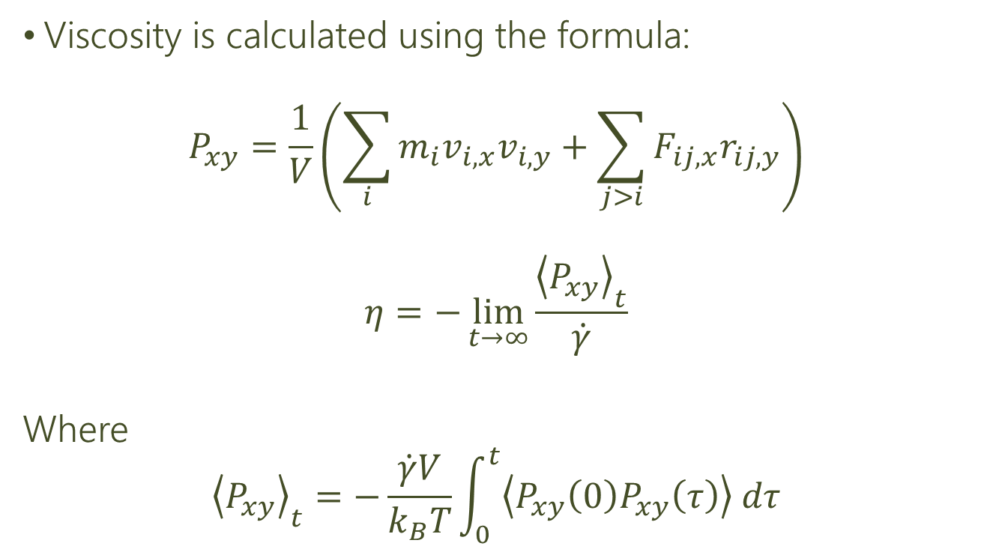
Calculation of Viscosity
Viscosity is calculated using the formula:
$$P_{xy}=\frac{1}{V}\left(\sum_{i}{m_{i}v_{i,x}v_{i,y}}+\sum_{j>i}{F_{ij,x}r_{ij,y}}\right)$$
$$η=−\lim_{t→∞}{\frac{{\left\langle P_{xy}\right\rangle }_{t}}{\dot{γ}}}$$
Where
$${\left\langle P_{xy}\right\rangle }_{t}=−\frac{\dot{γ}V}{k_{B}T}\int_{0}^{t}{\left\langle P_{xy}\left(0\right)P_{xy}\left(τ\right)\right\rangle dτ}$$

Slide 7
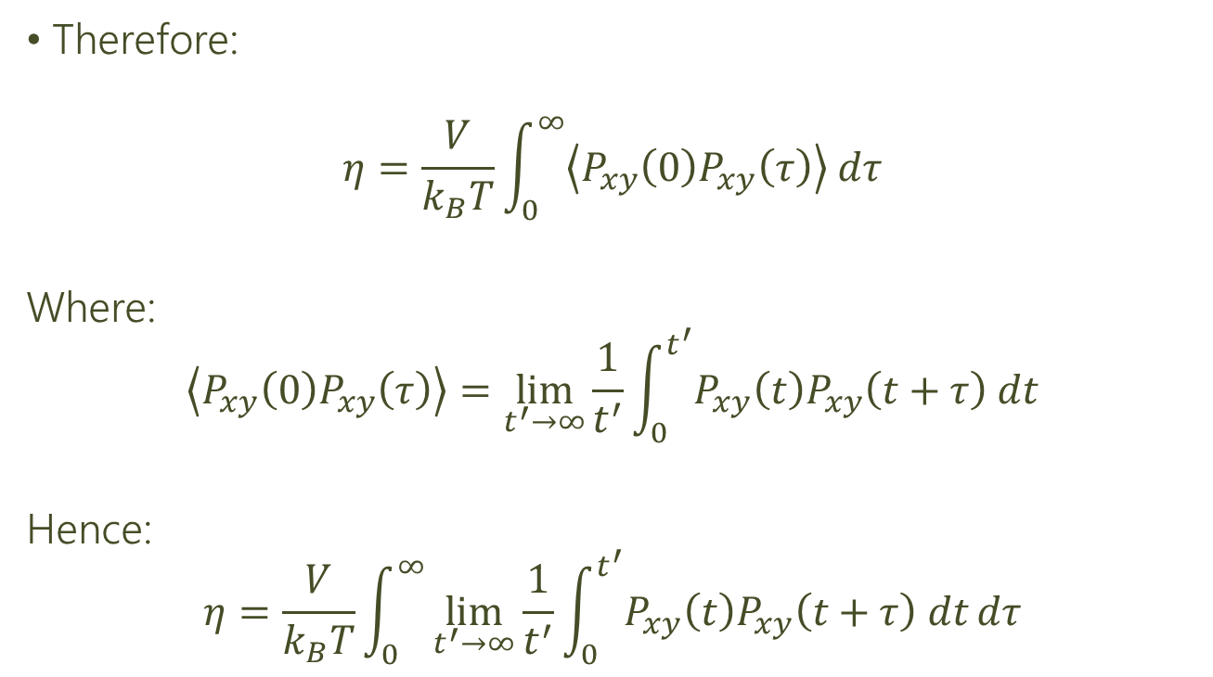
Calculation of Viscosity
Therefore:
$$η=\frac{V}{k_{B}T}\int_{0}^{∞}{\left\langle P_{xy}\left(0\right)P_{xy}\left(τ\right)\right\rangle dτ}$$
Where:
$$\left\langle P_{xy}\left(0\right)P_{xy}\left(τ\right)\right\rangle =\lim_{t^{′}→∞}{\frac{1}{t^{′}}}\int_{0}^{t^{′}}{P_{xy}\left(t\right)P_{xy}\left(t+τ\right) dt}$$
Hence:
$$η=\frac{V}{k_{B}T}\int_{0}^{∞}{\lim_{t^{′}→∞}{\frac{1}{t^{′}}}\int_{0}^{t^{′}}{P_{xy}\left(t\right)P_{xy}\left(t+τ\right) dt}dτ}$$

Slide 8
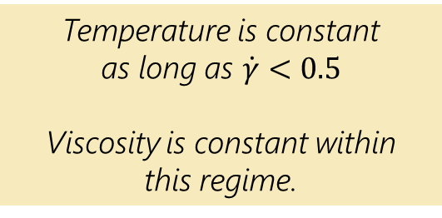
Variation of Shear Rate
Temperature is constant
as long as $\dot{γ}<0.5$
Viscosity is constant within
this regime.

Slide 9
Viscosity Measurements

Slide 10
Variation with particle number
Shear Rate: 0.1
Viscosity peaks sharply as we approach maximum packing density

Slide 11
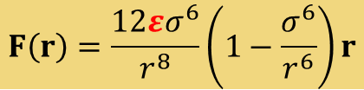
Variation of Repulsion Parameter
$$F\left(r\right)=\frac{12εσ^{6}}{r^{8}}\left(1−\frac{σ^{6}}{r^{6}}\right)r$$
Increasing repulsion parameter $ε$ increases viscosity
due to increased interaction forces

Slide 12
Variation of particle size
Weak effect of changing size of particles while keeping fill fraction constant

Slide 13
Mixed Particle Sizes
Weak effect of having a mixture of particle sizes

Slide 14
Colloid Particle Geometry

Slide 15
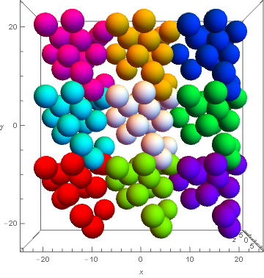
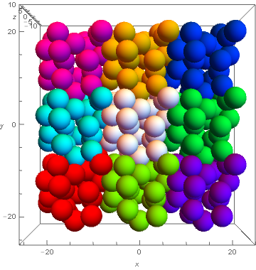
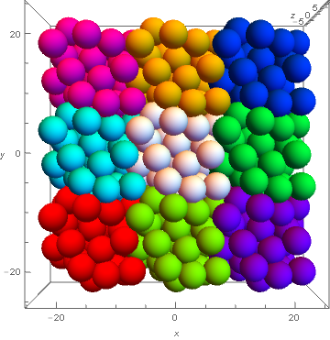
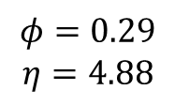
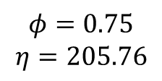
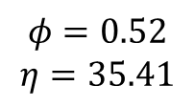
Fill Fraction
$$φ=0.29$$
$$η=4.88$$
$$φ=0.52$$
$$η=35.41$$
$$φ=0.75$$
$$η=205.76$$

Slide 16
Coordination Number

Slide 17
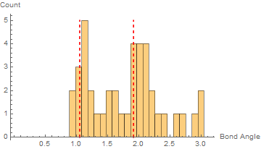
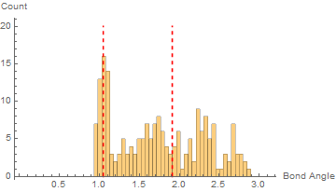
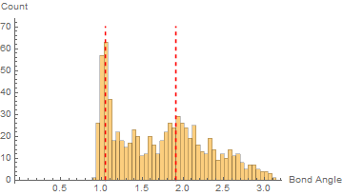
Bond Angle
Fill Fraction: 0.41
Coordination Number: 2.3
Fill Fraction: 0.52
Coordination Number: 4.1
Fill Fraction: 0.76
Coordination Number: 6.7

Slide 18
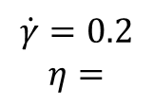
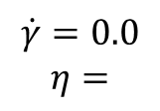
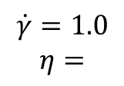
Shear Rate
$$\dot{γ}=0.0$$
$$η=$$
$$\dot{γ}=0.2$$
$$η=$$
$$\dot{γ}=1.0$$
$$η=$$

